Slide 1
Interrupt Handling & Trap Mechanisms
Hossam Monyr 202322240348
Myanganbayar Khaltar 202322240353
Salmi Mouaad 202322240339

Slide 2
How does your computer know when you’ve pressed a key, or when a download finishes?

Slide 3
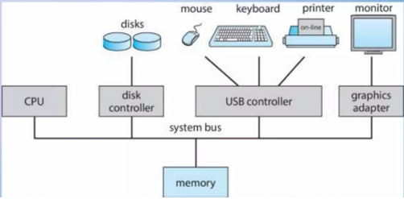
Introduction
Modern operating systems are reactive and dynamic systems — constantly interacting with hardware and software. Two key technologies that allow the OS to manage these interactions in real time are interrupts and traps.
Understanding these mechanisms helps us appreciate how operating systems achieve three vital properties: Responsiveness, Protection, and Efficient control over processes

Slide 4
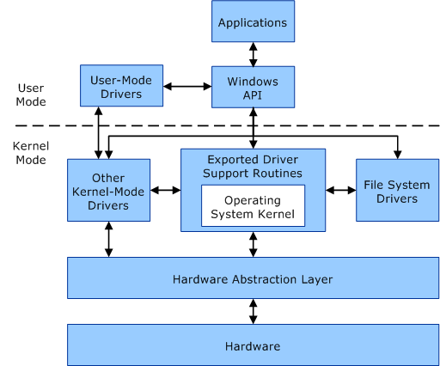
CPU Modes and Privilege Levels
Modern computer architectures implement multiple privilege levels to isolate user applications from system-level operations. Typically there are at least two modes: user mode and kernel (or supervisor) mode. These modes exist to protect system resources and ensure process isolation.
●In user mode, the executing process has restricted access to system resources. It cannot directly interact with hardware or access protected areas of memory. This restriction is essential for system stability and security.
● Kernel mode grants the operating system full access to all hardware and memory. When an interrupt or trap occurs, the CPU transitions into kernel mode to execute a designated service routine.For instance, executing a system call like read() from a C program triggers a trap, elevating the privilege level temporarily to execute kernel code safely.
The transition between these modes is tightly controlled to prevent unauthorized access or system corruption. Only trusted OS components can operate in kernel mode, while user applications are confined to a sandboxed environment.

Slide 5
Interrupts Overview
What are Interrupts?
An asynchronous condition or event triggered by hardware devices like keyboards, timers, or network interfaces that interrupts the normal flow of control in a program.
Basically interrupt is a signal
Signal means it can be generated from particular hardware or program execution
○ They demand the CPU's attention and force it to suspend its current execution context to service the event. This is achieved through the Interrupt Service Routine (ISR), which is registered in an interrupt vector table. Each interrupt line maps to a unique ISR. Interrupts are critical to OS responsiveness and concurrency and require precise management to avoid priority inversion or race conditions.
● Common Functions of Interrupts
○ Interrupt transfers control to the interrupt service routine generally, through the interrupt vector, which contains the addresses of all the service routines
○ Interrupt architecture must save the address of the interrupted instruction
○ A trap or exception is a software-generated interrupt caused either by an error or a user request
○ An operating system is interrupt driven

Slide 6
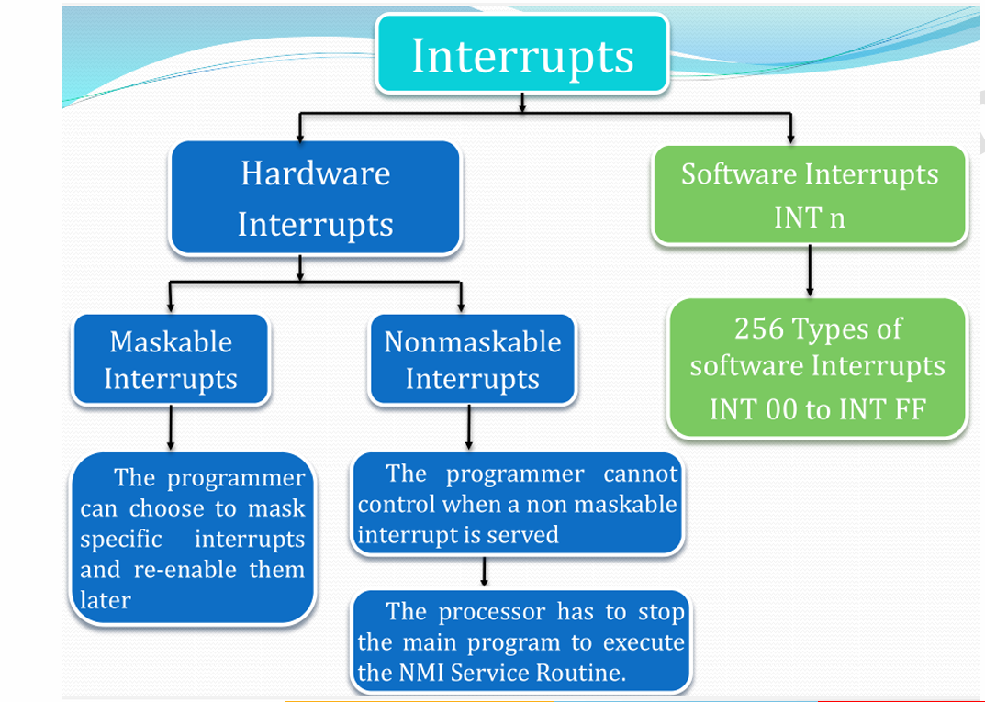
Types of Interrupts

Slide 7
The Interrupt Handling Process
Interrupt handling involves several steps. When an interrupt occurs, the CPU stops its current task, saves its state, and runs a special function called an Interrupt Service Routine (ISR) to handle the event. After that, it resumes where it left off.
Interrupt cycle:
Processor checks for interrupt
If no interrupt:
Fetch next instruction
If interrupt pending:
Interrupt Occurs : E.g., keyboard input; The device sends a signal (interrupt request) to the CPU
Current Instruction is Paused : CPU finishes current instruction; saves state (Program Counter, Registers).
Interrupt Vector Table Lookup : Based on interrupt number/type, fetches correct handler address.
Control Transfers to Handler : OS defined Interrupt Service Routine (ISR) runs.
ISR Executes Logic Responds to the interrupt (e.g., reads input, updates timers).
Restore Context and Resume : Control returns to previously interrupted process.
This process allows the system to be highly responsive without constantly checking (polling) devices. It’s like a waiter taking orders only when customers call them, not asking each table repeatedly

Slide 8
The Interrupt Handling Process
Upon receiving an interrupt, it must be handled by the operating system:
Handling is done by a procedure called an Interrupt Service Routine (ISR)
The operating system is invoked(Kernel Mode) and the ISR is called
Synchronous interrupts (traps and exceptions) do this immediately
Asynchronous interrupts go through a slightly different process
The operating system decides when to allow asynchronous interrupts
If interrupts are enabled, the CPU will check for pending interrupts
If several interrupts are pending, the OS will decide on which one to handle
The selected interrupt is then cleared and interrupts are disabled
Only then, the ISR is called, and upon returning, interrupts are reenabled

Slide 9
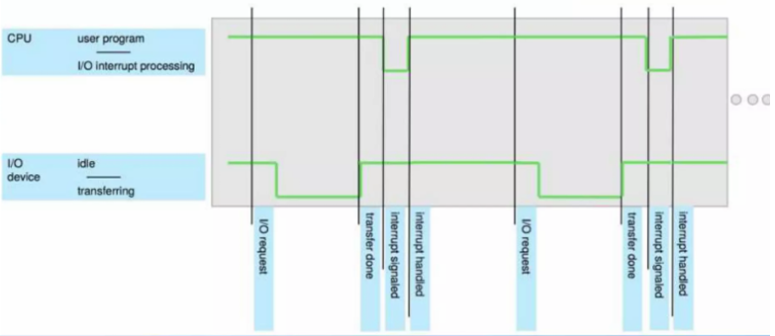
The Interrupt Handling Process

Slide 10
The Features of the ISR
The main features of the ISR are:
● Interrupts can occur at any time ,they are asynchronous. ISR’s can call for asynchronous interrupts
● Interrupt service mechanism can call the ISR’s from multiple sources
● ISR can handle both maskable and non maskable interrupts. An instruction in a program can disable or enable an interrupt handler call
● ISR on the beginning of an execution will disable other devices' interrupt services. After completion of the ISR execution it will re-initialize the interrupt services.

Slide 11
Trap Mechanisms
Traps allow a user program to transition safely into kernel mode. For example, when a program wants to open a file, it can’t do it directly—it must request the OS to do it. Here’s how it works:
1. A user program executes a special instruction (like `int 0x80` on x86 systems).
2. This causes a trap—a controlled jump into kernel mode.
3. The OS figures out what system call was requested.
4. It performs the action (e.g., reading a file).
5. It returns the result to the program.
Traps are used to invoke system-level services safely, and they serve as the foundation for implementing system calls. When a user application requires a service such as file I/O, memory allocation, or process control, it cannot directly perform these operations due to privilege restrictions. Instead, it issues a system call, which is internally implemented via a trap.
Each call has a unique number. When a syscall is made, the CPU jumps to the system call handler inside the kernel using a trap. Arguments are passed via registers or the stack, and results are returned back in a register.

Slide 12
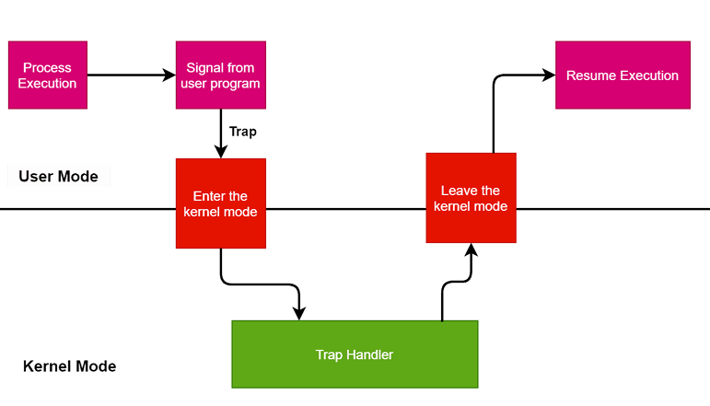
Trap Mechanisms

Slide 13
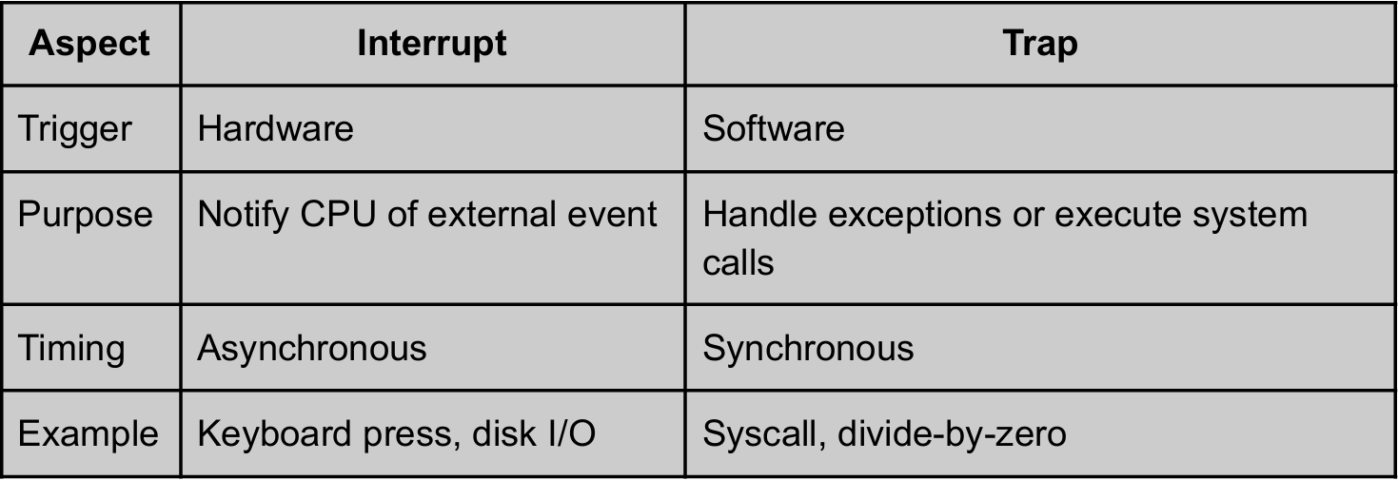
Traps VS Interrupts
The trap mechanism leverages a trap table, similar to the interrupt vector table, to redirect control to the kernel. For example, in Linux, invoking a system call like open() triggers int 0x80 or syscall instruction, depending on the architecture, to enter kernel space.
Understanding the differences helps you predict OS behavior. For example, a USB insert = interrupt; opening a file = trap; invalid pointer = exception.
These two mechanisms ensure that the CPU responds not only to user-level events but also handles critical system-level tasks like switching modes, managing memory, and process coordination.’.

Slide 14
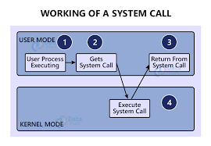
System Call Mechanism
System Call – Interface between user-level code and OS kernel (e.g., read, write, fork, exec).
System calls are software-triggered traps that allow user programs to request OS services. Each system call maps to a unique number and entry in the syscall table. On x86 systems, syscall or int 0x80 instructions are used to enter kernel mode. Parameters are passed via registers or stack. The OS identifies the syscall using the number and dispatches it to the corresponding handler. On completion, the return value is copied to a predefined register (like eax) before transitioning back to user space.
User Program Calls a System Functions Example: write() in C.
Trap Instruction (e.g., int 0x80 in x86) Switches mode from user to kernel.
Trap Handler in OS Executes the Requested Service
Return to User Space After Completion

Slide 15
Conclusion Interrupts and traps form the backbone of OS control and service execution. Operating Systems must efficiently manage transitions between user-level and kernel-level execution. Interrupts and traps are two core mechanisms that facilitate this transition. Interrupts allow the processor to respond to asynchronous events, while traps offer a mechanism for software to invoke services from the operating system. System calls, which are invoked through traps, represent the user’s gateway to access privileged operations provided by the OS kernel.
Efficient interrupt handling ensures performance making the system responsive, while trap mechanisms guarantee system integrity.Whether we’re writing device drivers, designing secure systems, or optimizing performance, mastering these mechanisms is crucial for guiding modern operating systems.

Slide 16
Thank You

